Slide 1
Research Project Workshop 03:
Research Data Management (RDM) Best Practices
April 05, 2017
Instructor: Letisha Wyatt, PhD

Slide 2
learning outcomes
1 Describe RDM best practices in organizing files
and data and how you might implement
these in your work
2 Identify essential elements to consider for your
experimental design
3 Understand ways to standardize your data
and the utility of the data dictionary

Slide 3
research and data lifecycles
Research Life Cycle
Data Discovery
Data
Archive
Re-Use
Plan
Repository
Adapted from here
Discover
Collect
Planning
Proposal
Writing
Project
Start
Assure
Project End
Share
Data Life Cycle
Describe
Analyze
Preserve

Slide 4
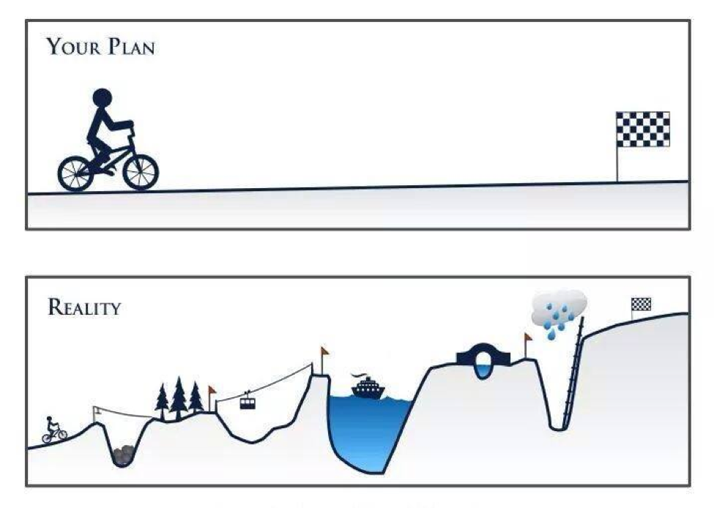

Slide 5
data management plan (dmp)
Collection:
Where is the raw data?
Format and volume?
Methods?
Variables and units?
Assurance:
Validation or standards (instruments/data)
Missing values?
Description:
Descriptive details about the project & experiment
Plan
Analyze
Collect
Assure
Discover
Data Life Cycle
Share
Describe
Preserve
http://www.dcc.ac.uk/resources/data-management-plans
Notes:
REVIEW FROM LAST TIME
collection: raw data (machine, xls, paper)
Assurance: standards relates to outliers

Slide 6
data management plan (dmp)
Preservation:
Data volume?
Back up schedule?
3 Back up locations?
How long to save it?
Sharing:
Public repository?
Sensitive data?
Analysis:
Tools (software)?
Plan
Analyze
Collect
Assure
Discover
Data Life Cycle
Share
Describe
Preserve
http://www.dcc.ac.uk/resources/data-management-plans
Notes:
sharing: Funder/publisher requirements? quality of repository?
analysis: ties to sharing - how are your tools affect that?

Slide 7
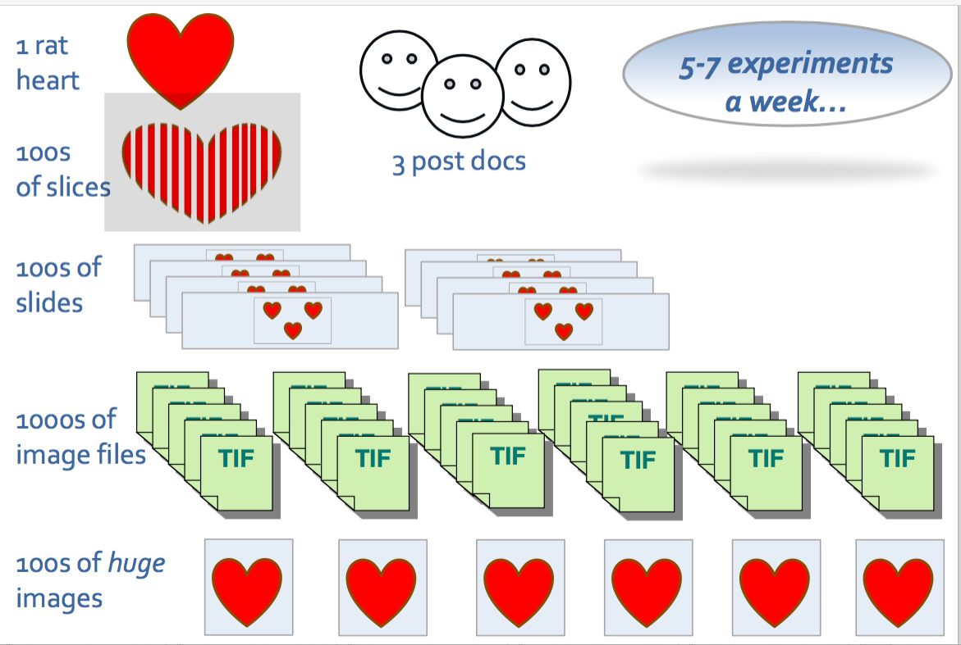
Notes:
Does this apply to you? – think about it…
Can get out of hand quickly!

Slide 8
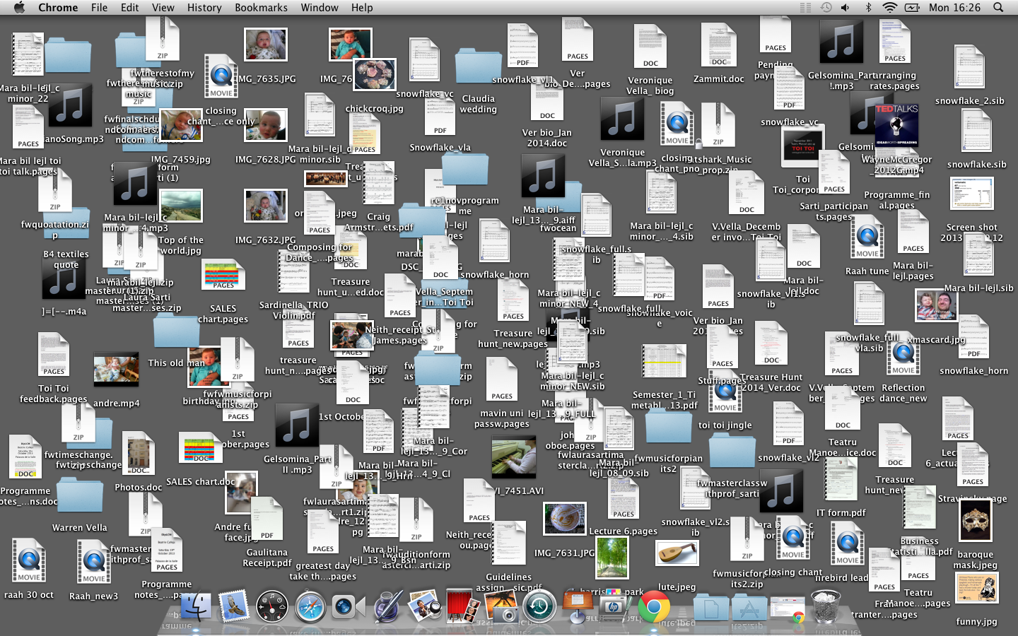
Notes:
Does your desktop look like this?

Slide 9
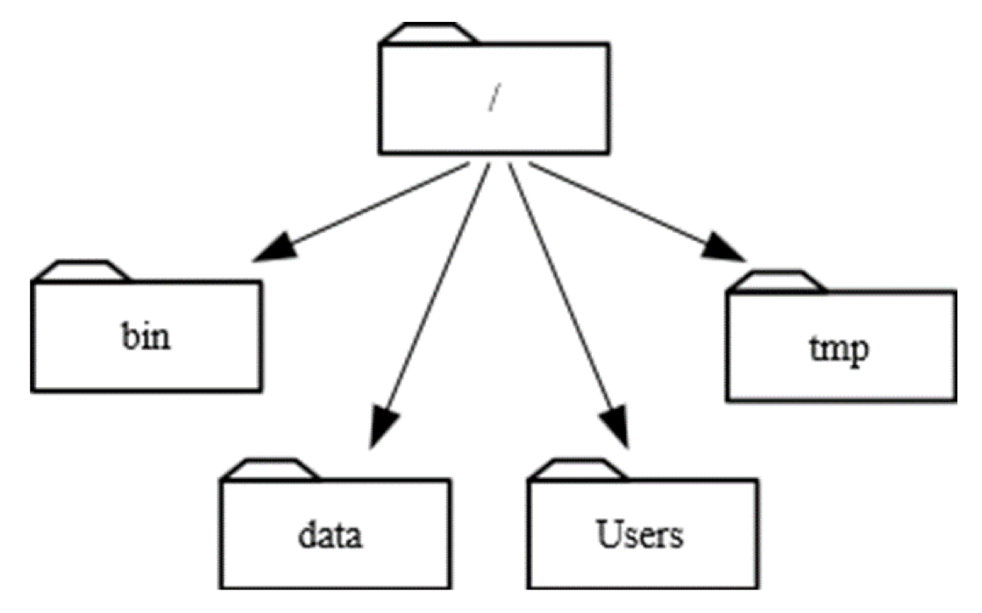
organizing your files
Hierarchy - computer operating systems
Tags - Gmail
Organize by
Project
Experiment
Date
Course
Manuscript/Grant
File type
Others?
Adapted from MIT Libraries
Notes:
5 min
=25 min
Hierarchies are great for one person/small team not great for collabo
Tags let you put an item in multiple categories, mistagging/inconsistent tagging is a problem (citation management software work arounds on computers – adding tags to files and/or making shortcuts)
How do you organize?
http://arc.leeds.ac.uk/using-the-systems/getting-started/using-linux-the-basics/

Slide 10
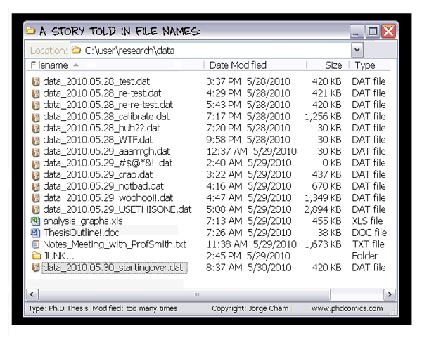

Slide 11
naming your files
Bad
bob_1262011.tif
Descriptive as possible
Consistent for related files
YYYYMMDD or YYMMDD (per ISO)

Slide 12
naming your files
Better
project name_experiment name or desc_date_creator_v1
Avoid special characters
Use underscores, dashes, or periods for separation
Forced ordering by numbering with leading zeros

Slide 13
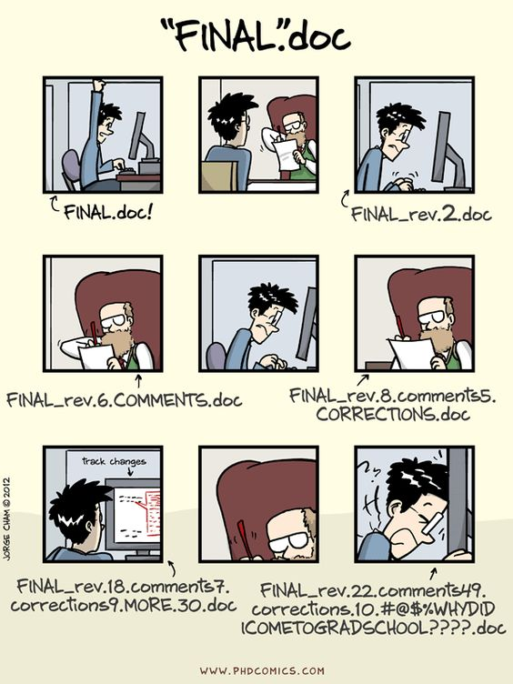



versioning
Notes:
SENSITIVE DATA ALERT – PHI review

Slide 14
experimental design
Notes:
important especially when it comes to sharing your data
Rigor and reproducibility is the broad theme

Slide 15
significance & premise
Scientific significance Importance of the proposed problem for advancing scientific knowledge.
Scientific premise Evaluation of the citations used as the basis for the proposal. Identification of strengths and weakness.
“rigor of experimental design, relevant biological variables, authentication of key resources”
Notes:
Coming from the NIH - highlight new requirements to look more critically at citations
http://grants.nih.gov/reproducibility/faqs.htm#4825

Slide 16
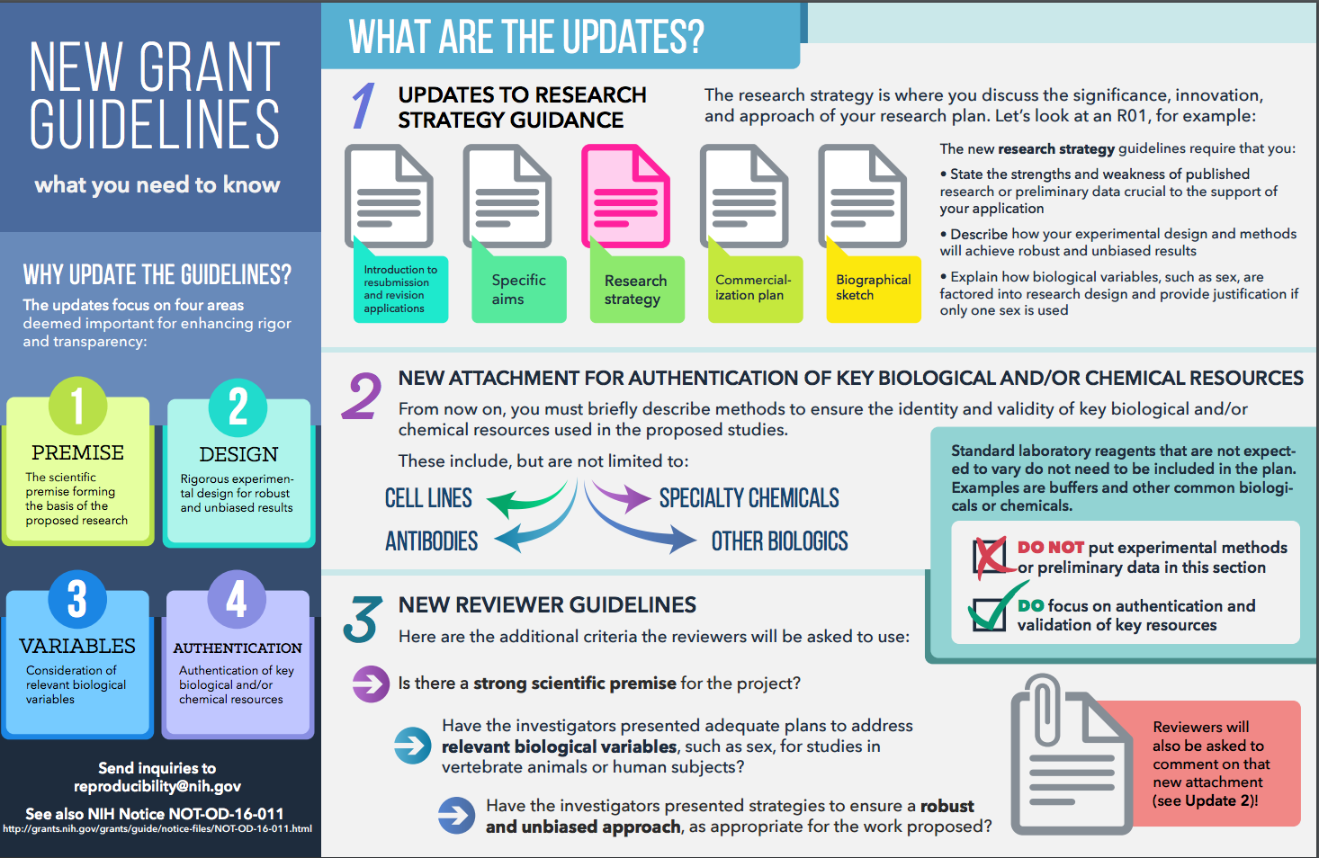
Source: NIH on reproducibility

Slide 17
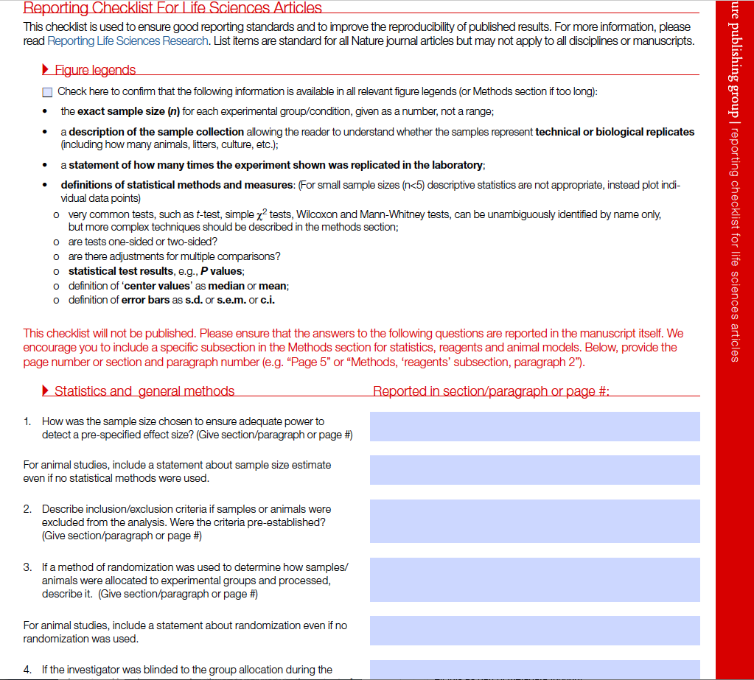
nature checklist
Adapted from: OHSU Open Educational Resources
Notes:
More on figure legends later in the series!

Slide 18
controlling bias
blinding: masking elements of the experiment
randomization: randomly assigning experimental groups or treatments
inclusion/exclusion criteria
(or primary endpoints)
dealing with outliers

Slide 19
experimental design details
Statistical power: typically 80%, chance/probability of ”getting it right”. As sample size goes ↑ power goes ↑
Sample size: function of power and error rate (typically 0.05)
Effect size: an estimated effect size is needed (strength of phenomenon), often determined by pilot or published studies
Handy explanations and calculators:
http://biomath.info/power/
http://www.surveysystem.com/sscalc.htm
http://powerandsamplesize.com/
Notes:
Want to point this out b/c this is important part of planning prior to data collection. IACUC and IRB will want to know how you thought about these details
*basic descriptive statistics and tests understanding required

Slide 20
standardizing data
Notes:
Relates to QA as well

Slide 21
lessons from clinical research
Relatively regulated industry
Things done well:
Study Protocol deviations
CRFs (case report forms)
Dual data entry & reconciliation
Quality assurance

Slide 22
give it a try…
Notes:
Vitamin D Study Protocol -> Identify data elements in small groups (15 min); create a ”form” to capture necessary data
trade with another group and compare data elements and form (10 min)
where to standardize?
Study Protocol received from https://github.com/clirdlf/eresearchnetwork
License to resuse: http://creativecommons.org/licenses/by/4.0/

Slide 23


Where can I find data standards for animal research?
Arrive guidelines checklist
Arrive guidelines examples
Adapted from: OHSU Open Educational Resources

Slide 24

Where can I find data standards for clinical research?
Common Data Elements (CDEs) were developed by NIH
For use in clinical research, patient registries, human subject research
Goal: Improve data quality and opportunities for comparison and combination of data from multiple studies
https://www.nlm.nih.gov/cde/
Adapted from: OHSU Open Educational Resources
Notes:
Repository where you find are a number of survey tools for different subjects that contain data elements that should be collected = standardization!

Slide 25
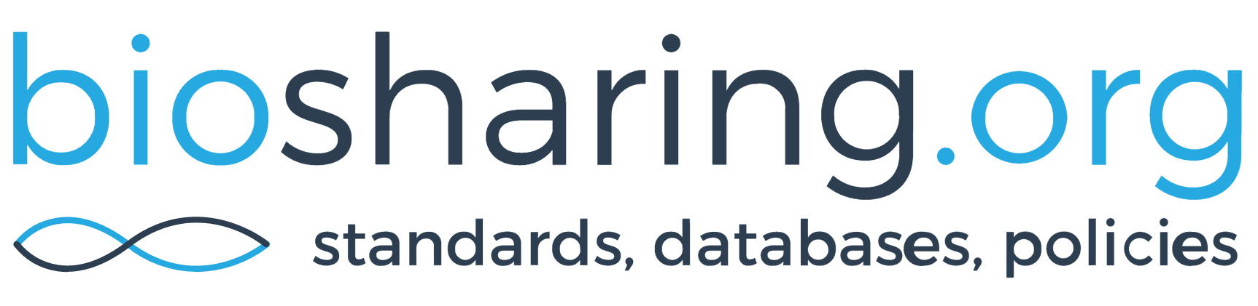
Where can I find data standards for bioscience research?
Adapted from: OHSU Open Educational Resources
Notes:
Identify standards for your field – worksheet (10 min)

Slide 26
the take away
Be aware that data standards exist and try to apply them where applicable:
during data collection
during data reporting
Many databases exist that curate the literature, and if the data is reported in a standardized way, it makes data curation all that much easier.

Slide 27
organizing your data

Slide 28
tabular data
Source: DataOne
Notes:
Always keep raw data separate!

Slide 29

problems with the data?
Adapted from WGEA 2017 Seminar
Notes:
This document provided by Jennifer Dinalo and L. Kysh through a workshop titled “Student See, Student Do: Mentoring Students in Research Data Management” at the AAMC Western Group on Education Affairs 2017 meeting.

Slide 30
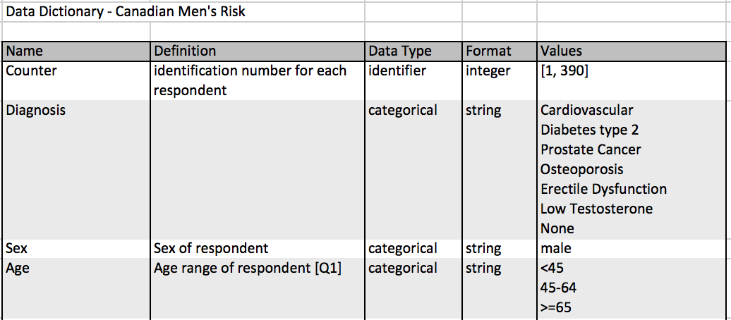
data dictionary
Data dictionary
The purpose of a data dictionary is to ensure consistent terminology throughout a dataset
It contains a list of descriptive data types that are being collected
Example:
Source: OHSU Open Educational Resources
Notes:
Exercise: use the worksheet to create a data dictionary for the previous (cigarette smoking) example and/or for your on experiment(s) (10 min)

Slide 31
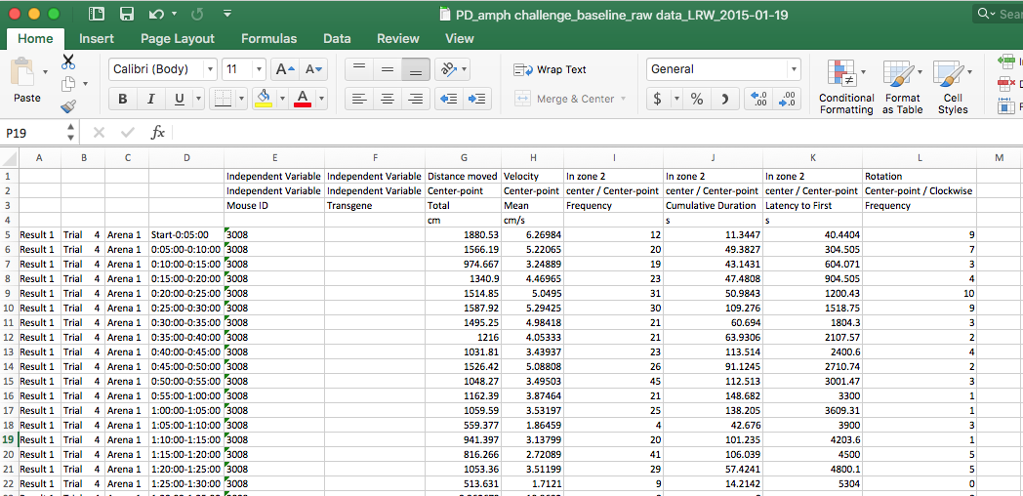
data dictionary for organization
Notes:
Letisha’s example

Slide 32
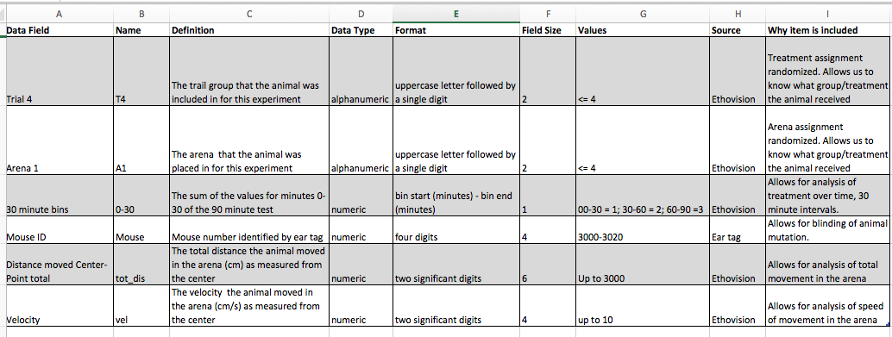
data dictionary for organization
Notes:
Letisha’s example

Slide 33
a note on data quality
Quality assurance: ensuring quality in your processes
Validation or standards instruments
Validation or standards instruments
Discovery of and dealing with missing values
Restricting data types, data validation, and data provenance
Notes:
Exercise: create data validation/entry limitations on the xls; enter the data for the cigarette study (10 min)

Slide 34

OHSU REDCap – you can use it
REDCap = research electronic data capture
Free to anyone with OHSU credentials – OHSU REDCap
Other option for data collection (direct entry or import)
Creates data dictionaries automatically during db set up
Applicable to clinician AND basic science researchers
Notes:
Active data collection
Download dictionaries
Download data pipe to OSF

Slide 35
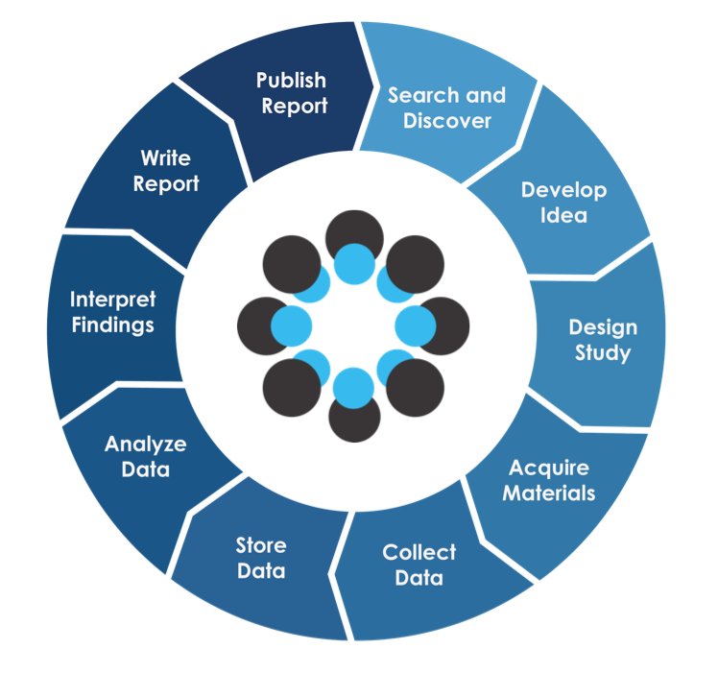
Open Science Framework (OSF)
Notes:
WORKFLOW TIP!
serves as a place to “collect” data but also for the many other RDM purposes discussed in today’s workshop = addressing rigor and repro issue
Connects with figshare, github, google drive, Box, Dropbox and other places you store your files/data
(review) Useful guides for OSF: http://help.osf.io/

Slide 36
recap
1 Describe RDM best practices in organizing files
and data and how you might implement
these in your work
2 Identify essential elements to consider for your
experimental design
3 Understand ways to standardize your data
and the utility of the data dictionary

Slide 37
questions?
Letisha R. Wyatt, PhD
wyattl@ohsu.edu
BICC 341
503.494.8627

